Slide 1
Web Service之 http基础原理
主讲：马永亮(马哥)
QQ群:169777636
客服QQ：2813150558, 1661815153
http://www.magedu.com
http://mageedu.blog.51cto.com

Slide 2
Web Service之 httpd基本应用
主讲：马永亮(马哥)
QQ群:169777636
客服QQ：2813150558, 1661815153
http://www.magedu.com
http://mageedu.blog.51cto.com

Slide 3
Web Service之
编译安装httpd-2.4
主讲：马永亮(马哥)
QQ群:169777636
客服QQ：2813150558, 1661815153
http://www.magedu.com
http://mageedu.blog.51cto.com

Slide 4
I/O模型与web
服务器并发
主讲：马永亮(马哥)
QQ群:169777636
客服QQ：2813150558, 1661815153
http://www.magedu.com
http://mageedu.blog.51cto.com

Slide 5
Web Service之
LAMP
主讲：马永亮(马哥)
QQ群:169777636
客服QQ：2813150558, 1661815153
http://www.magedu.com
http://mageedu.blog.51cto.com

Slide 6
编译安装LAMP
主讲：马永亮(马哥)
QQ群:169777636
客服QQ：2813150558, 1661815153
http://www.magedu.com
http://mageedu.blog.51cto.com

Slide 8
应用层
应用层
应用层细节
用户进程
表示层
会话层
套接字
传输层
tcp
udp
网络层
IPv4, IPv6
内核
数据链路层
设备驱动程
序和硬件
通信
细节
物理层

Slide 9
内核
内核
发送缓冲
接收缓冲
接收缓冲
发送缓冲

Slide 13
proxy, proxy-fcgi
httpd-2.4: mpm
  module
    prefork: libphp5.so
    worker, event: libphp5-zts.so
  cgi
  fastcgi
http://www.magedu.com/pma/index.php
DocumentRoot “/var/www/html”
fcgi://172.16.100.8:9000/pma/index.php

Slide 15
www.magedu.com
image.imgmagedu.com

Slide 17
MVC
index.php

Slide 18
index.html
  logo.gif
  binner.jpg
  a.css
  b.css

Slide 20
跨Internet的主机间通讯
客户端
应用程序
服务器端
应用程序
使用TCP/IP
的主机
使用TCP/IP
的主机
LAN
LAN
router
router
WAN
router
router
router
router

Slide 21
DNS

Slide 23
GUI
  elinks, lynx
CLI

Slide 24
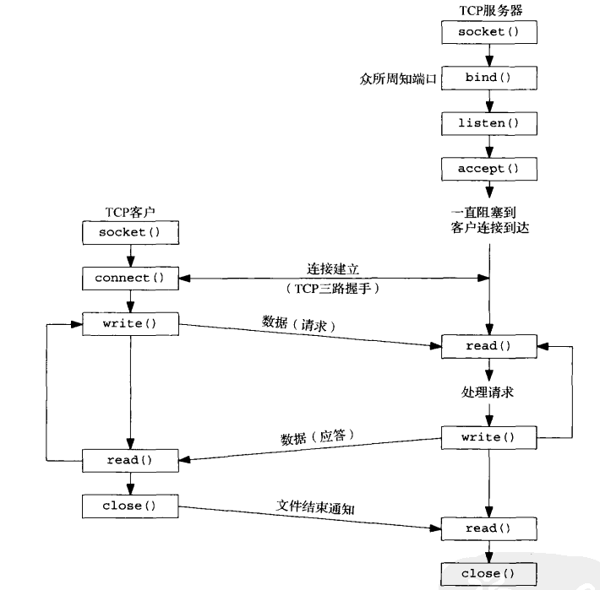
基本TCP客户/服务器程序的套接字函数

Slide 25
CLOSED
LISTEN
SYN_SENT
SYN_RECV
ESTABLISHED
FIN_WAIT1

Slide 26
FIN_WAIT1
CLOSE_WAIT
FIN_WAIT2
TIME_WAIT
LAST_ACK
CLOSED

Slide 29
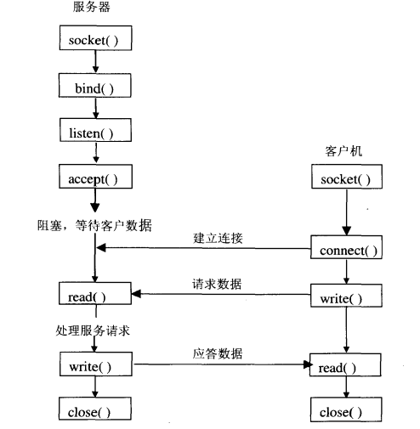
阻塞模式

Slide 30
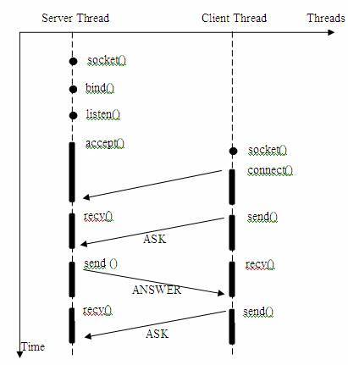

Slide 31
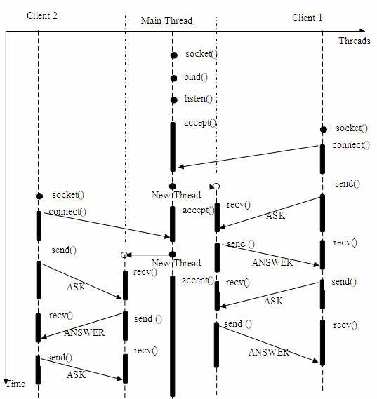
多进程或多线程

Slide 32
套接字
  监听的套按字
  已连接套接字
Server
监听套接字
Client1
Server
子进程1
已连接套接字
Client2
Server
子进程2
已连接套接字

Slide 33
IPC
  Inter Process Communication
同一主机进程
  信号、旗语、shm
  Unix Sock
跨主机的进程
  rpc
  socket

Slide 36
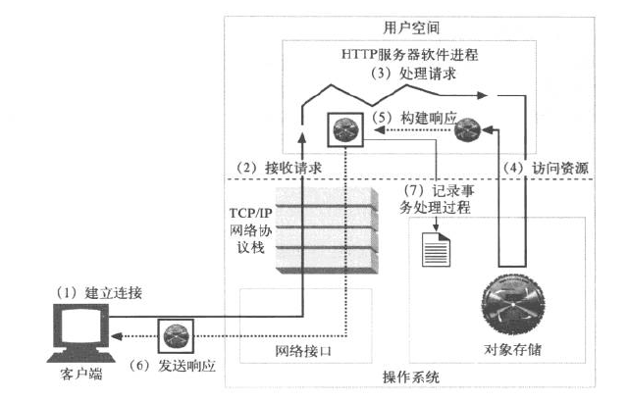
基本的Web服务请求步骤

Slide 39
thread

Slide 41
task_struct: 任务结构
2560*86400
Docroot: /var/www/html/
/var/www/html/images/logo.gif
http://www.magedu.com/images/logo.gif

Slide 43
index.html

Slide 44
I/O工作模型

Slide 45
c, php,
bash

Slide 46
1000
  800: 静态
  200：bash进程

Slide 48
ip:port
  172.16.100.7:80
host: www.mageedu.com

Slide 50
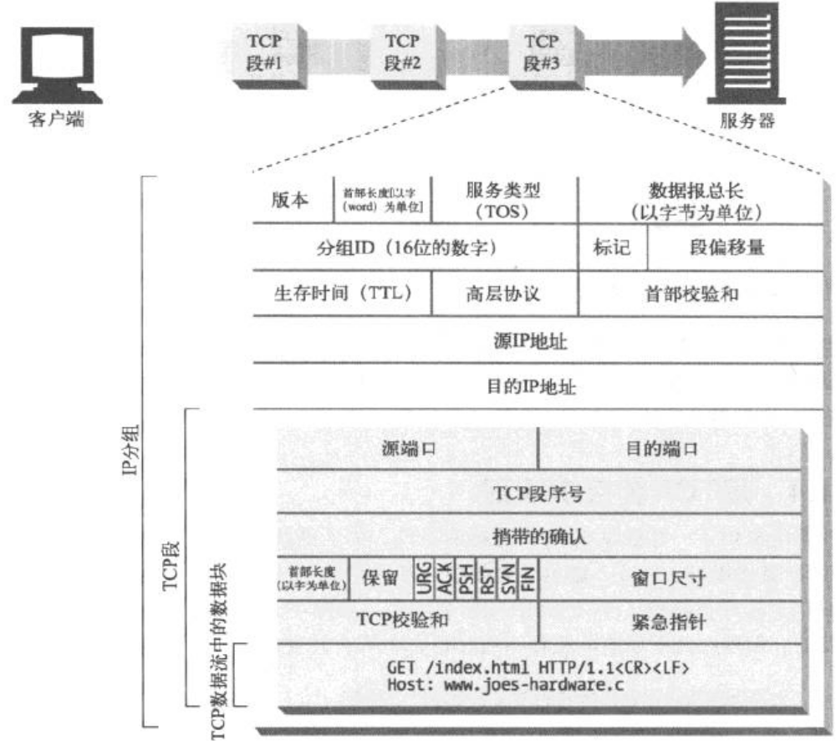
http报文传输

Slide 51
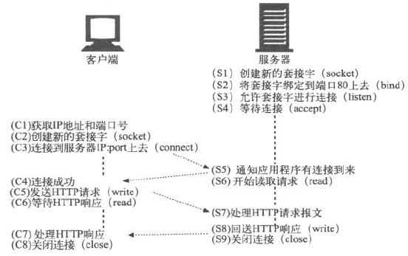
HTTP基于TCP套接字通信

Slide 52
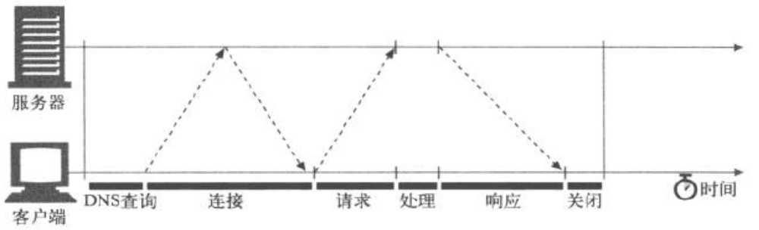
HTTP事务时延

Slide 53
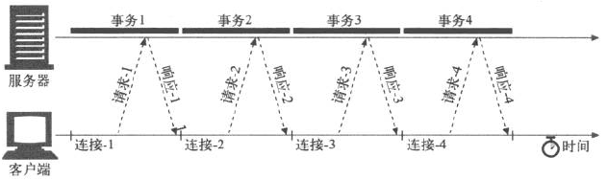
串行事务处理时延
提高性能
  并行连接
  持久连接

Slide 54
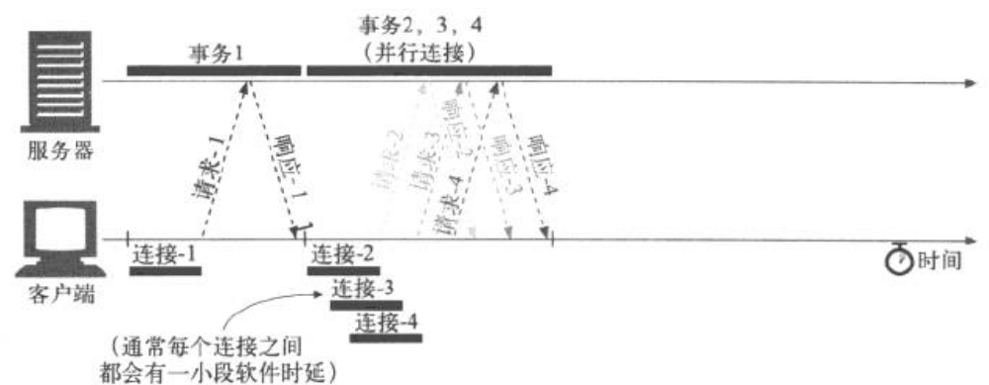
并行连接示例: 4个事务
缺点
  每个事务都会打开/关闭一条新的连接，会耗费时间和带宽
  由于TCP的慢启动特性的存在，每条新连接的性能都会有所降低
  可打开的并行连接数量实际上是有限的

Slide 55
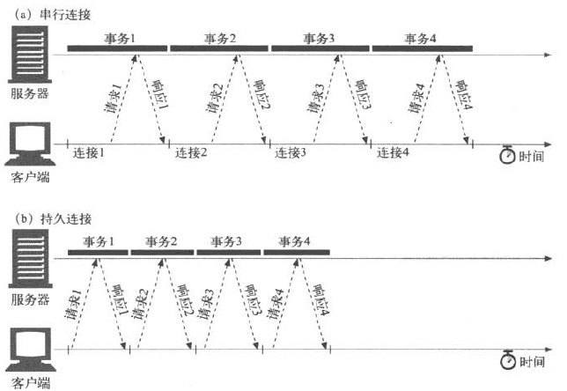
持久连接 V.S. 串行连接

Slide 57
HTTP协议用户识别机制
承载用户身份信息的HTTP首部
客户端IP跟踪，通过用户的IP地址对其进行识别
用户登录，用认证的方式来识别用户
胖URL，一种在URL中嵌入识别信息的技术
cookie，一种功能强大且高效的持久身份识别技术

Slide 58
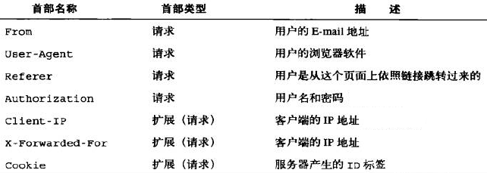
用于承载用户信息的HTTP首部

Slide 59
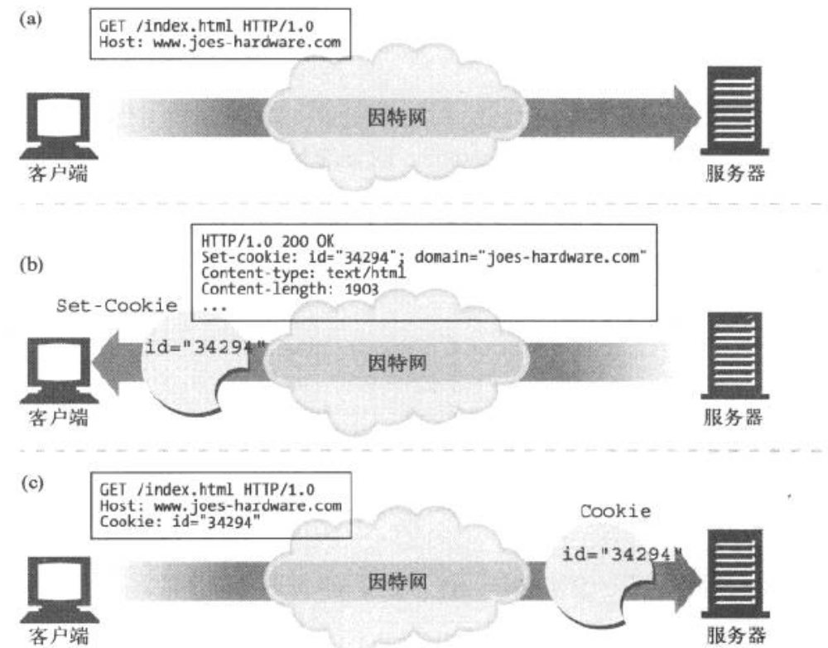
cookie的工作示例

Slide 60
MPM
  prefork
  worker
  event

Slide 61
HTTP事务
  request
    <method> <request-URL> <version>
    Name: Value
    Name: Value
    <entity-body>
  response
    <version> <status> <reason>
    Name: Value
    Name: Value
    <entity-body>

Slide 62
MIME
  major/minor

Slide 63
172.16.100.7
www.a.com
  web.a.com
www.b.org
www.c.net
  Host: www.a.com

Slide 64
godaddy
wordpress

Slide 65
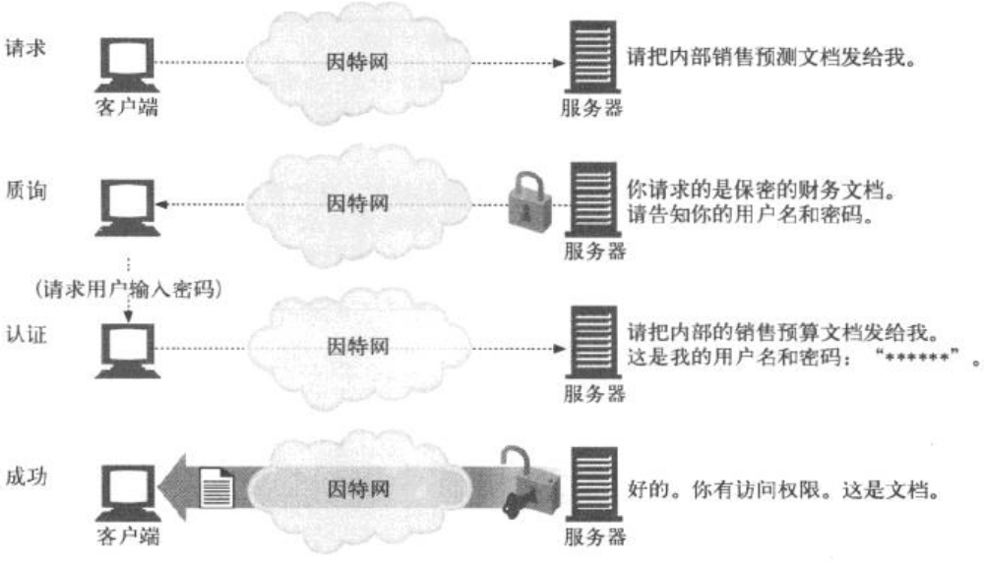
HTTP认证

Slide 66
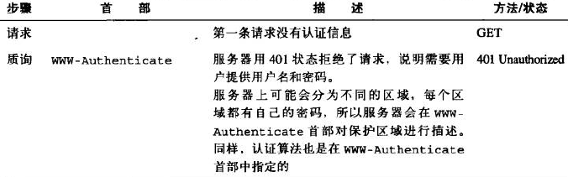
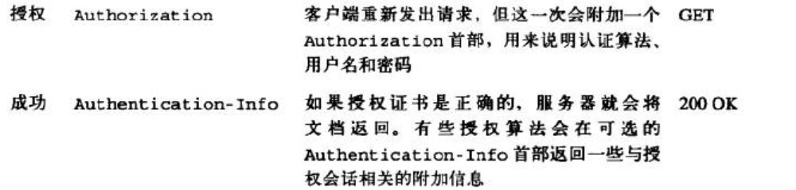
认证的4个步骤

Slide 67
https
  ssl/tls
  ssl: Secure Socket Layer
    sslv3
  tls: Transport Layer Security
    tlsv1

Slide 68
www.magedu.com

Slide 69
并发响应模型
  网络编程

Slide 70
prefork

Slide 73
ODBC
API: Application Programming Interface
sql

Slide 75
DBA
SQL语句
计划执行器
分析器
操作求解器
优化器
事务
管理器
文件和存取接口
恢复
管理器
缓冲管理器
锁管
理器
磁盘空间管理器

Slide 78
1

Slide 81
.php
mysql-devel
--with-mysql

Slide 82
php-fpm

Slide 83
LAMP

Slide 85
AddType text/html .php

Slide 86
4000$
5000$

Slide 92
连接管理器
查询
缓存
分析
器
查询引擎

Slide 93
php, html
fastcgi, fcgi
httpd
php

Slide 95
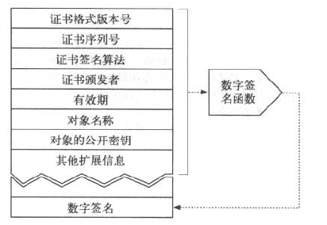
HTTPS
数字证书

Slide 96
SSL握手
交换协议版本号
选择一个两端都了解的密码
对两端的身份进行认证
  web应用场景中，服务端很少对客户端进行认证
生成临时的会话密钥，以便进行加密通信

Slide 97
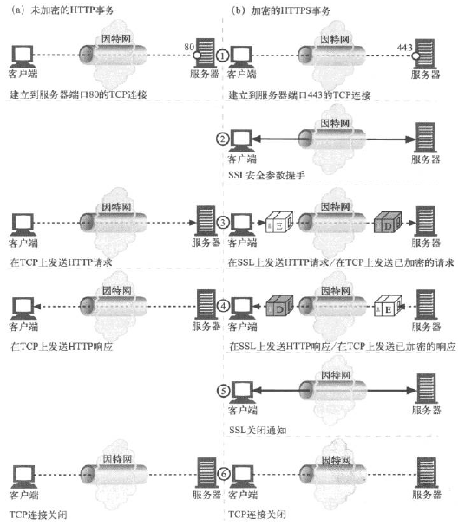
HTTP事务 V.S. HTTPS事务

Slide 98
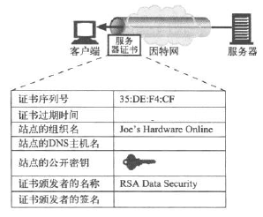
站点证书有效性
日期检测
签名颁发者可信度检测
签名检测
站点身份检测

Slide 99
回顾：
  CGI、用户认证、虚拟主机、https、server-status

Slide 100
html, css, plain
40k, 15k
mp3, jpeg
filter:

Slide 101
100, 10000
10000, 100

Slide 103
http,
  socket, tcp
  domain
    unix: 文件路径
    ipv4: ipv4:port
    ipv6: ipv6:port

Slide 106
阻塞I/O
recvfrom
系统调用
准备数据
进程被阻塞于recvfrom
数据准备完成
复制
返回调用成功
处理数据
复制完成

Slide 107
非阻塞I/O
recvfrom
系统调用
非阻塞
准备数据
数据准备完成
阻塞
复制
返回调用成功
处理数据
复制完成

Slide 108
I/O复用
select/poll
系统调用
阻塞
准备数据
recvfrom
数据准备完成
阻塞
复制
返回调用成功
处理数据
复制完成

Slide 109
信号驱动I/O
SIGIO
sigaction
系统调用
非阻塞
准备数据
recvfrom
数据准备完成
阻塞
复制
返回调用成功
处理数据
复制完成

Slide 110
异步I/O
aio_read
系统调用
准备数据
非阻塞
数据准备完成
复制
处理数据
返回调用成功
复制完成

Slide 114
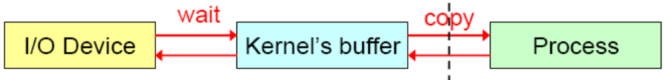
I/O动作如何执行？
进程无法直接操作I/O设备，其必须通过系统调用请求kernel来协助完成I/O动作
内核会为每个I/O设备维护一个buffer
对于输入而言，等待(wait)数据输入至buffer需要时间，而从buffer复制(copy)数据至进程也需要时间
根据等待模式不同，I/O动作可分为五种模式

Slide 115
Five I/O Models
blocking I/O: blocked all the way
nonblocking I/O: if no data in buffer, immediate returns EWOULDBLOCK
I/O multiplexing (select and poll): blocked separately in wait and copy
signal driven I/O (SIGIO): nonblocked in wait but blocked in copy (signaled when I/O can be initiated)
asynchronous I/O (aio_): nonblocked all the way (signaled when I/O is complete)

Slide 116
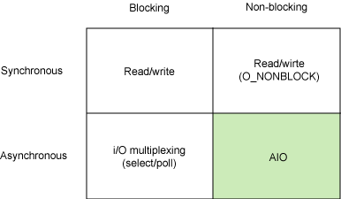
同步I/O和异步I/O
Synchronous I/O：引起请求进程阻塞，直到I/O完成；
Asynchronous I/O：不导致请求进程阻塞；

Slide 117
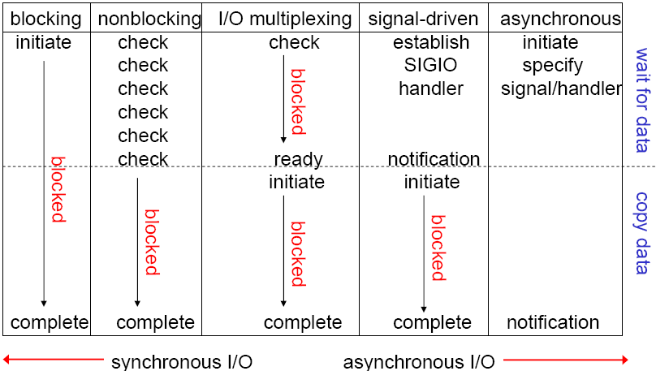
Comparison of Five I/O Models

Slide 118
Blocking versus Multiplexing
If we want to read from multiple devices, we are not able to do it properly with the read() system-call
If one device has no data, our task will be blocked, and so can’t read data that may become available from some other device

Slide 119
Idea: use ‘nonblocking’ i/o
When we ‘open()’ a device-file, we could specify the ‘O_NONBLOCK’ i/o mode
For the keyboard: two problems with this:
  The ‘stdin’ device is already open by default
  If a task tries to do multiplexing with devices that have been opened in non-blocking mode, it will likely consume way too much cpu time!

Slide 120
Better idea: use ‘select()’
The ‘select()’ system-call was designed to allow applications to efficiently perform i/o multiplexing
With ‘select()’ the application informs the kernel as to which system devices it is interested in
The kernel then ‘polls’ those devices, to see if any of them is ready to do i/o without blocking
If not, it puts the process to sleep until at least one device is ready to do i/o without blocking

Slide 121
select/poll/epoll
select
  本质上是通过设置或者检查存放fd标志位的数据结构来进行下一步处理
  缺点
    单个进程可监视的fd数量被限制，即能监听端口的大小有限
      # cat /proc/sys/fs/file-max
    对socket进行扫描时是线性扫描，即采用轮询的方法，效率较低
    需要维护一个用来存放大量fd的数据结构，这样会使得用户空间和内核空间在传递该结构时复制开销大

Slide 122
select/poll/epoll
poll
  本质上和select没有区别，它将用户传入的数组拷贝到内核空间，然后查询每个fd对应的设备状态
  其没有最大连接数的限制，原因是它是基于链表来存储的，但是同样有一个缺点：
    大量的fd的数组被整体复制于用户态和内核地址空间之间，而不管这样的复制是不是有意
    poll还有一个特点是“水平触发”，如果报告了fd后，没有被处理，那么下次poll时会再次报告该fd

Slide 123
select/poll/epoll
epoll
  支持水平触发和边缘触发，最大的特点在于边缘触发，它只告诉进程哪些fd刚刚变为就需态，并且只会通知一次
  使用“事件”的就绪通知方式，通过epoll_ctl注册fd，一旦该fd就绪，内核就会采用类似callback的回调机制来激活该fd，epoll_wait便可以收到通知
  优点:
    没有最大并发连接的限制：能打开的FD的上限远大于1024(1G的内存上能监听约10万个端口)
    效率提升：非轮询的方式，不会随着FD数目的增加而效率下降；只有活跃可用的FD才会调用callback函数，即epoll最大的优点就在于它只管理“活跃”的连接，而跟连接总数无关
    内存拷贝，利用mmap()文件映射内存加速与内核空间的消息传递；即epoll使用mmap减少复制开销

Slide 124
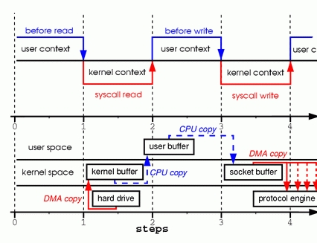

Slide 125
I/O复用
服务器进程需要一种预先告知能力，使得内核一旦发现进程指定的一个或多个I/O条件就绪，它就通知进程。这个能力就称作I/O复用。

Slide 126
起始行
  request
    <method> <url> <version>
  response
    <version> <status code> <reason_phrase>
  http headers
  空白行
  <body>

Slide 127
mpm_winnt, MPM
Method
  GET
  POST
  HEAD
  PUT
  DELETE
  OPTIONS
  TRACE
  CONNECTION
Web服务器的工作模型
  单进程/单线程
  多进程/多线程
    prefork, worker
    maxclients
      prefork: 256
      worker: 150
  一个进程响应多个请求
    请求：状态
    监控状态
      基于事件
    event
  多个进程响应N个请求

Slide 128
web程序：
  编程语言，代码
    脚本语言
      适用于web应用程序开发的语言或语言框架
      支持编译功能的脚本型语言, 编译成中间代码
        jsp(java bytecode), php(zend engine, opcode)
    编译语言
      效率高

Slide 130
htpasswd
  htpasswd [ -c ] [ -m ] [ -D ] passwdfile username
  htpasswd is used to create and update the flat-files used to store usernames and password for basic authentication of HTTP users
  -c
    Create the passwdfile
    If passwdfile already exists, it is rewritten and truncated
  -m
    Use MD5 encryption for passwords
  -D
    Delete user

Slide 131
Web Server
  Many Web Sites
  Port
  IP
  FQDN
  <VirtualHost HOST>
    DocumentRoot “/path/to/site”
    ServerName www.test.com
  </VirtualHost>

Slide 132
.htaccess files (or "distributed configuration files") provide a way to make configuration changes on a per-directory basis.
A file, containing one or more configuration directives, is placed in a particular document directory, and the directives apply to that directory, and all subdirectories thereof.

Slide 133
AuthType
  selects that method that is used to authenticate the user
  The most common method is Basic, and this is the method implemented by mod_auth_basic
  The Basic authentication sends the password from the client to the server unencrypted
AuthName
  sets the Realm to be used in the authentication
  The realm serves two major functions
    First, the client often presents this information to the user as part of the password dialog box.
    Second, it is used by the client to determine what password to send for a given authenticated area.

Slide 134
AuthUserFile
  Sets the path to the password file that created with htpasswd.
  If you have a large number of users, it can be quite slow to search through a plain text file to authenticate the user on each request
  Apache also has the ability to store user information in fast database files
  The mod_authn_dbm module provides the AuthDBMUserFile directive
    These files can be created and manipulated with the dbmmanage program.

Slide 135
Require
  Provides the authorization part of the process by setting the user that is allowed to access this region of the server.

Slide 136
The suEXEC feature provides Apache users the ability to run CGI and SSI programs under user IDs different from the user ID of the calling web server.
  Used properly, this feature can reduce considerably the security risks involved with allowing users to develop and run private CGI or SSI programs.

Slide 137
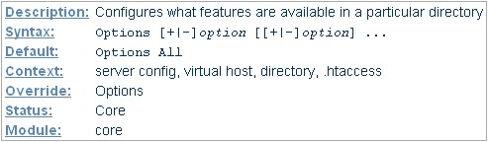
Options
All
  All options except for MultiViews. This is the default setting.
ExecCGI
  Execution of CGI scripts using mod_cgi is permitted.
FollowSymLinks
  The server will follow symbolic links in this directory.

Slide 138
Includes
  Server-side includes provided by mod_include are permitted.
IncludesNOEXEC
  Server-side includes are permitted, but the #exec cmd and #exec cgi are disabled. It is still possible to #include virtual CGI scripts from ScriptAliased directories.
Indexes
  If a URL which maps to a directory is requested, and there is no DirectoryIndex (e.g., index.html) in that directory, then mod_autoindex will return a formatted listing of the directory.
MultiViews
  Content negotiated "MultiViews" are allowed using mod_negotiation.
SymLinksIfOwnerMatch
  The server will only follow symbolic links for which the target file or directory is owned by the same user id as the link.

Slide 139
Apache Access Configuration
Apache provides directory- and file-level host-based access control
Host specifications may include dot notation numerics, network/netmask, and dot notation hostnames and domains
The order statement provice control over “order”, but not always in the way one might expect
  order allow, deny -- allow explicitly allowed clients, denies everyone else; clients matched by both allow and deny are denied

Slide 140
Flat File Authentication
<Directory /var/www/html/secret>
  AuthName “realm”
  AuthType basic
  AuthUserFile /path/to/password_files
  Require valid_user
</Directory>

Slide 141
  Require user user1, user2, …
  Require gorup group1, group2, …
  Require valid_user
    Anyone in the user file can access the realm
Multiple Requires possible

Slide 142
Installing mod_ssl
Stop httpd before installing mod_ssl
  yum install -y mod_ssl*
/etc/httpd/conf/ssl.* directories
Generate SSL key and certificate
  Manually with openssl
  Using /etc/pki/tls/certs/Makefile
Edit /etc/httpd/conf.d/ssl.conf

Slide 143
SSL Virtual Hosts
SSL virtual hosting requires a unique IP address per site
  Limitation of SSL , not mod_ssl or Apache
Generate or obtain key and certificate, add three lines to Virtualhost block
  SSLEngine on
  SSLCertificateFile /etc/httpd/conf/ssl.crt/name.crt
  SSLCertificateKeyFile /etc/httpd/conf/ssl.key/name.key

Slide 144
bypass: 旁路
php 5.3.3
php-fpm
memcached
slave
slave
master
redis
NoSQL

Slide 146
LAMP
rpm: LAMP
LAMP
  编译：php modules
  php, fcgi server
  httpd, mysql, php

Slide 148

关于马哥教育
博客：http://mageedu.blog.51cto.com
主页：http://www.magedu.com
QQ：2813150558, 1661815153, 113228115
QQ群：169777636, 279599283

Slide 149
Thank You!

